Slide 1





Garbage Classification
Presented by: Anshula

Slide 2

Learning Objectives
Understand and apply Convolutional Neural Networks (CNNs)
Learn how to preprocess image datasets for classification tasks
Implement a real-world ML solution using Python & TensorFlow
Evaluate model performance and improve accuracy
Promote environmental awareness through technology
GOAL
Source :
www.freepik.com/

Slide 3
Tools and Technology used
Python 🐍
TensorFlow & Keras 🧠
NumPy & Pandas 📊
Matplotlib 📈
Google Colab 💻
OpenCV for image processing
Jupyter Notebook for code testing

Slide 4
Methodology
Data Collection: Kaggle dataset with 6 garbage categories
Data Preprocessing: Resize, normalize, augment
Model Creation: CNN with multiple Conv2D and MaxPooling2D layers
Training & Validation: Fit model using training/validation split
Evaluation: Check accuracy, loss, confusion matrix
Prediction & Testing: Test on unseen images

Slide 5
Problem Statement:
In many regions, waste is not sorted properly, leading to environmental issues and health hazards. Manual sorting is inefficient and risky.There is a strong need for an automated, intelligent solution.

Slide 6
Solution:
Detects and classifies waste into 6 categories
Works in real-time using camera or image input
Can be integrated into smart bins or recycling plants
Boosts eco-friendliness through tech 🤖♻️

Slide 7
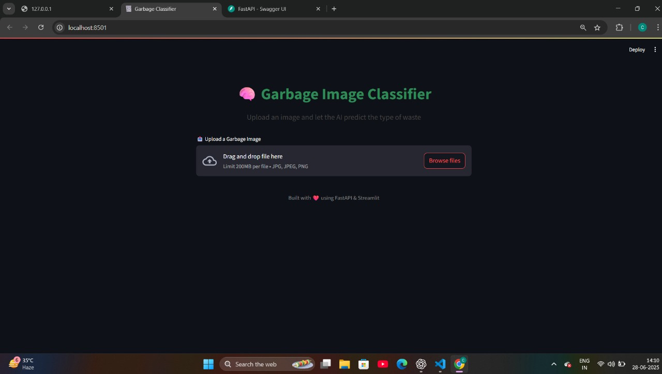
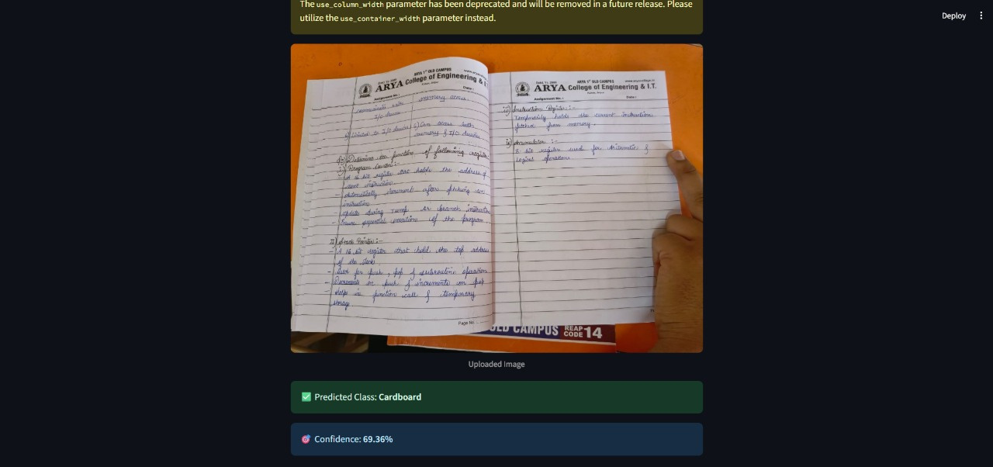
Screenshot of Output:

Slide 8
Conclusion:
Built a working model for garbage classification using CNN
Achieved high accuracy with a well-structured pipeline
Promotes smart waste management
Future Scope:
Deploy in mobile apps or IoT-based smart bins
Improve performance using transfer learning (e.g., MobileNet, ResNet)

Slide 9
Github links:
Dataset link: https://github.com/anshula1610/Garbage_class.git
Project link: https://github.com/anshula1610/garbage_classification_project.git

